Slide 1
SMART DISEASE DETECTION SYSTEM IN PLANTS
BY: Guide By:-
Rohan O Chikorde Prof. Prasad Pujar
Shubhma Godse Dept CSE
Abhishek Shelke
Ifran Hussian

Slide 2

Contents:
Introduction
Literature review
Objectives
Existing Methodology
Proposed Methodology
System Design
Road Map
References

Slide 3
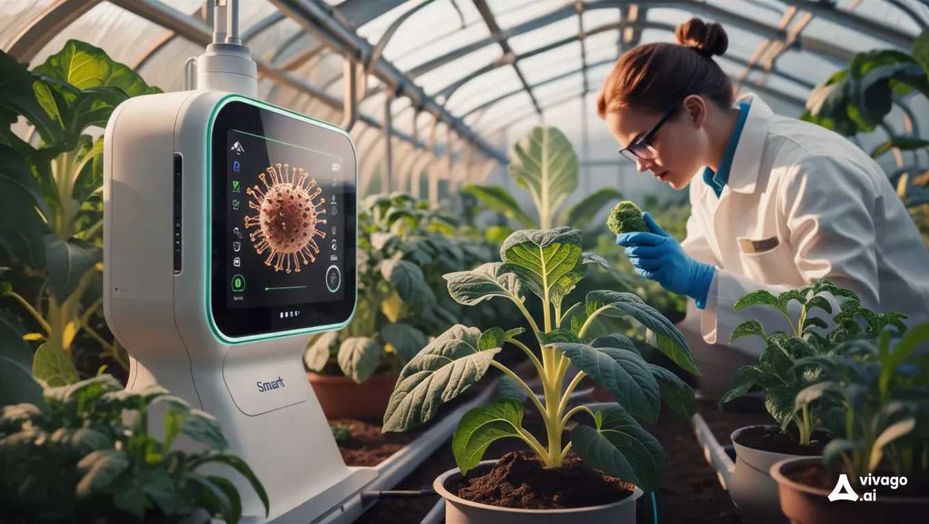
INTRODUCTION
A Smart Disease Detection System in plants and crops refers to the utilization of advanced technologies. Like Machine learning to accurately identify, diagnose. Monitor diseases affecting agricultural plants and crops.
The goal of these systems is to improve the efficiency and precision of disease detection, enabling farmers to implement timely and effective management strategies to protect crop health and enhance agricultural productivity..

Slide 4

LITERATURE REVIEW
Diagnosing plant diseases is a crucial part of contemporary agriculture, as it significantly affects crop output and food security. [1]
Conventional diagnostic techniques frequently require a lot of work and time, and they mostly rely on laboratory analysis and professional expertise. [2]
The recent breakthroughs in plant disease detection systems, highlighting the merging of image processing, machine learning, and remote sensing technologies. Using a combination of methods, the system takes pictures of plant leaves. High-resolution photos are taken with smartphones or drones that are fitted with cameras. After then, these images are processed through image analysis and algorithms that improve features associated with disease symptoms, like color changes, lesions, and textural variations.
Models for machine learning are instructed on large datasets of healthy and diseased plants and then classify the images based on the features that have been identified. [3]
The incorporation of convolutional neural networks (CNNs) has greatly increased the accuracy of disease detection, allowing the system to identify a variety of diseases in different plant species.[4]

Slide 5

OBJECTIVES
Enhance Early Disease Detection: Develop an automated system capable of identifying diseases at the earliest stage to prevent their spread and reduce crop losses.
Increase Detection Accuracy: Utilize advanced machine learning and computer vision techniques to accurately detect and classify various crop diseases across different plant types.
Promote Cost-Effectiveness: Ensure the system is cost-effective for small-scale farmers, making advanced disease detection technology accessible to a broader agricultural community.
Facilitate User-Friendly Access: Develop a user-friendly interface for farmers, allowing easy access to disease detection reports, monitoring data, and alerts via mobile devices or web platforms.

Slide 6

EXISTING METHODOLOGY
Traditional Visual Inspection Description: Farmers or agricultural experts manually inspect crops for signs of disease, often identifying issues based on color changes, spots, or deformities in leaves and stems.
Limitations: This method is time-consuming, requires expertise, and is prone to human error.
Early disease symptoms may be difficult to detect visually, leading to delays in intervention.

Slide 7

PROPOSED METHODOLOGY
Data Collection: Capture plant images, deploy IoT sensors (temperature, humidity, soil moisture) for real-time monitoring, and use historical disease data.
Data Preprocessing: Enhance image and sensor data quality; label images with disease types for accurate model training.
Model Training: Train a CNN for image-based disease detection, apply transfer learning for adaptability, and develop models to analyze environmental data from IoT sensors.
Interface: Provide a mobile app and dashboard for easy access to disease diagnostics, sensor data, and alerts.
Field Testing & Deployment: Validate in-field, deploy on cloud platforms, and maintain cost-effective, sustainable IoT solutions for continuous crop health monitoring.

Slide 8
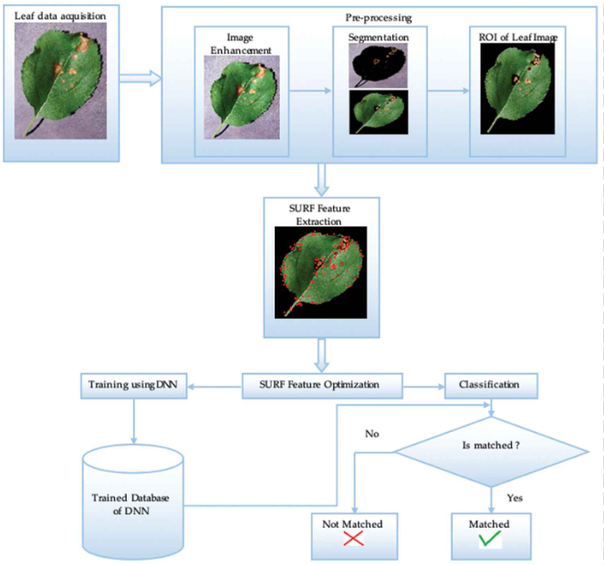
SYSTEM DESIGN
Segmentation: This sub-step involves separating the leaf from the background.
ROI (Region on Interest) of Leaf Image: The segmented leaf image is obtained, highlighting the specific areas of the leaf that need to be analyzed for disease symptoms.
Speeded-Up Robust Features (SURF) is an algorithm used for feature detection. In this step, SURF is applied to extract key features from the leaf image.

Slide 9
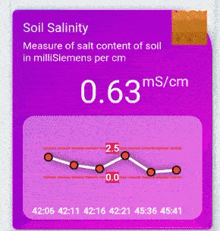
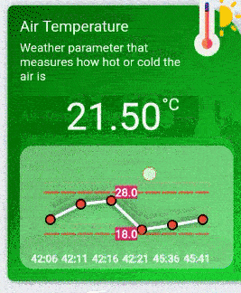
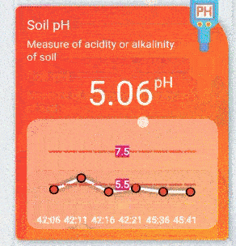

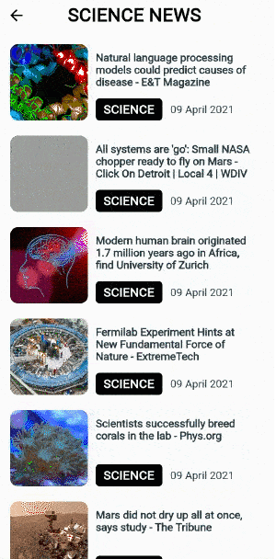
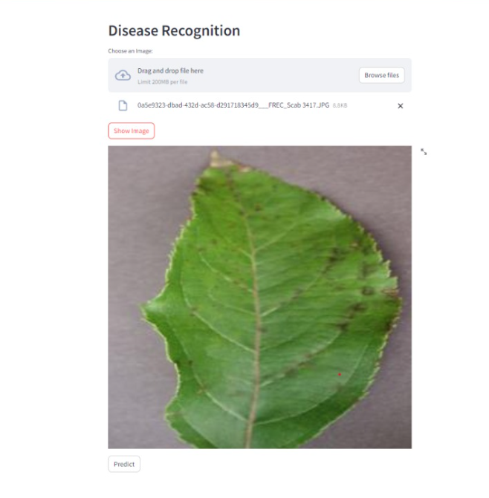
SYSTEM DESIGN

Slide 10


ROAD MAP
Research & Planning
Technology Selection
System Design
Data Collection
Model Development
Deployment
Monitoring & Maintenance
Testing & Validation
Integration

Slide 11
REFERENCES

Slide 12
Thanks You !

